Slide 1


Stroke Prediction Dataset
Kelompok 2
Nabila Mutiara Sifia / 23090230005
Milan Andariana / 23090230009
Lintang Berliana / 23090230013

Slide 2
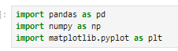
Highlights

Slide 3
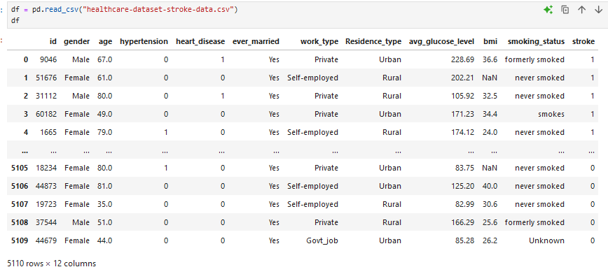

Slide 4
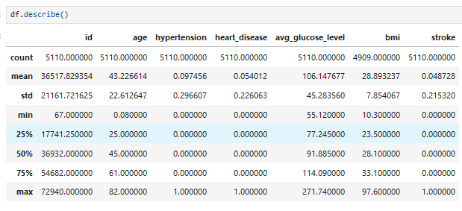

Slide 5
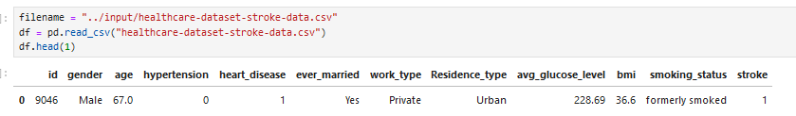

Slide 6
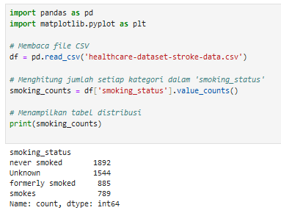

Slide 7
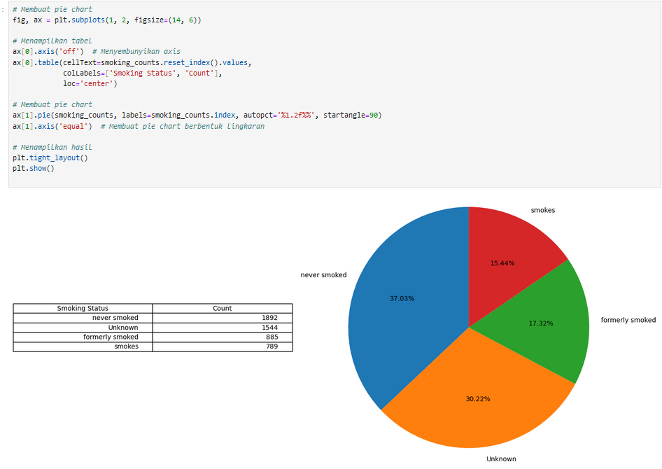

Slide 8
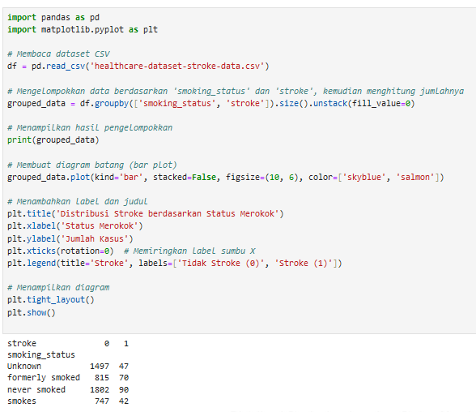
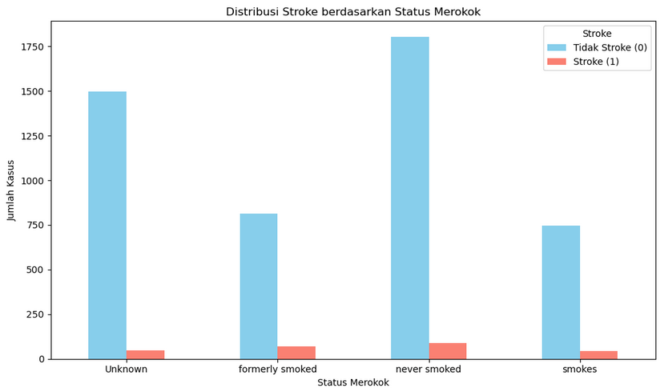

Slide 9
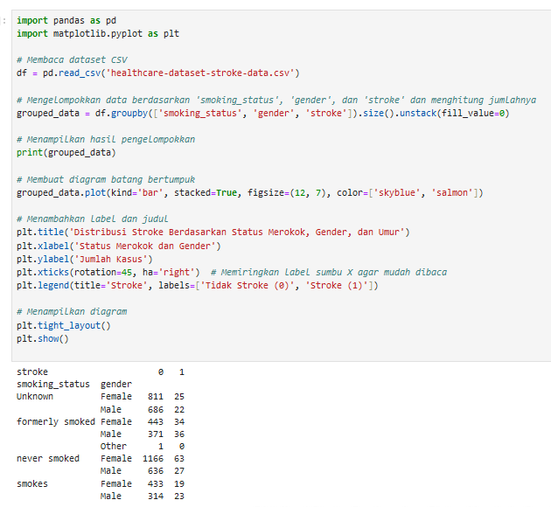
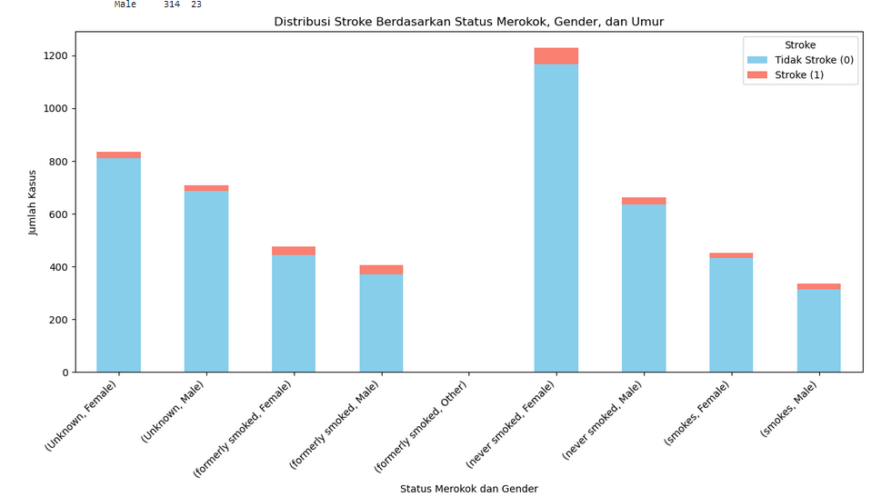

Slide 10
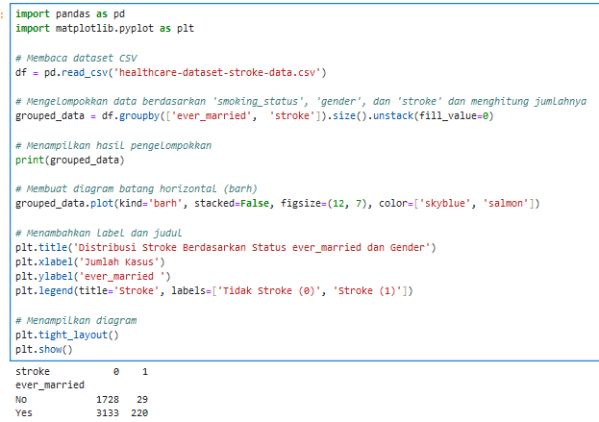
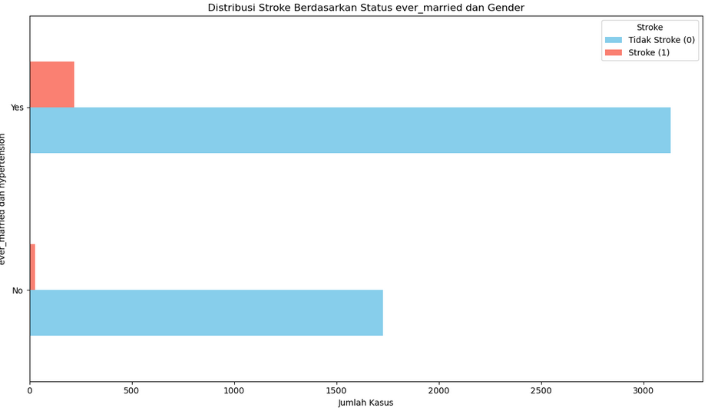

Slide 11
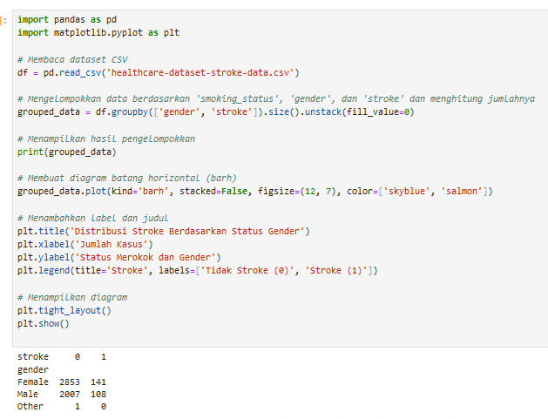
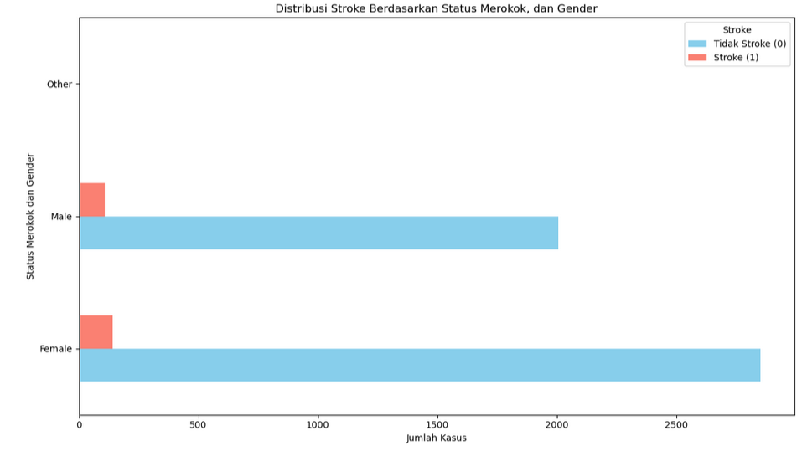

Slide 12
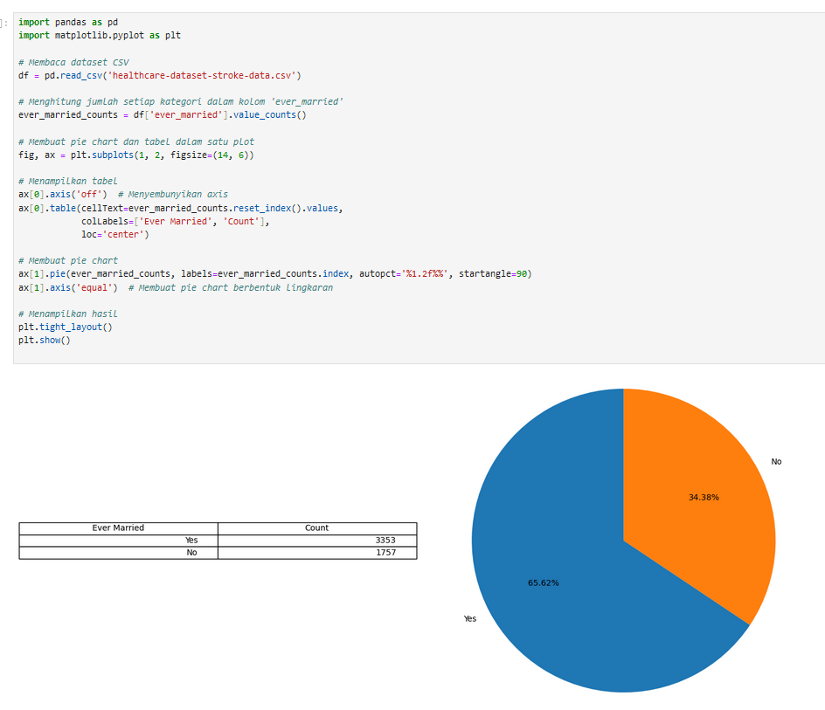
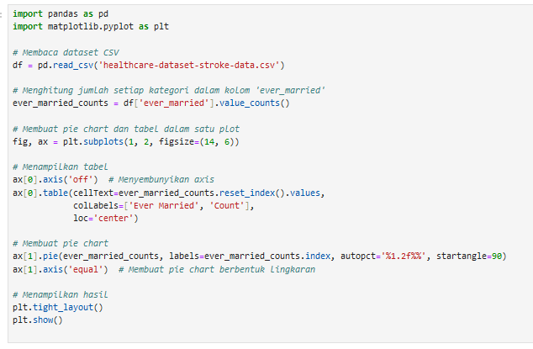

Slide 13
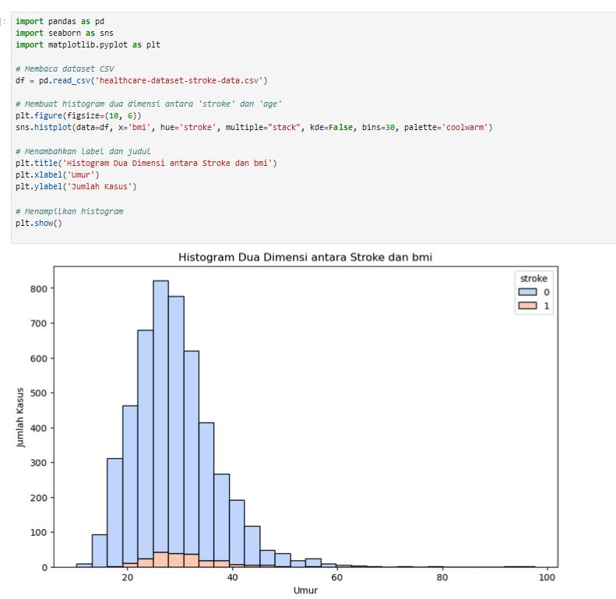

Slide 14
LINK GITHUB
https://github.com/NabilaM01/SUPERVISED-MACHINE-LEARNING.git

Slide 15
TERIMA KASIH

Slide 16






























Free Resources
Use these free, recolourable icons and illustrations in your
Canva design.

